Slide 1
SQL Research Project
Presented By
Manali Debnath
Top Ranked Data Science & Analytics Education Provider since 2007

Slide 2

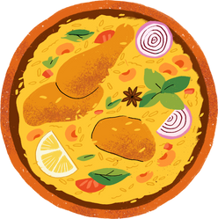
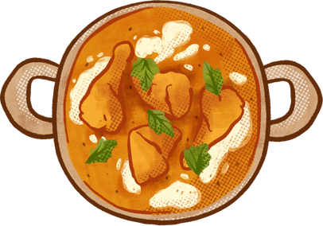












Zomato Data Analysis
For An Eatery Startup
Notes:
Hello everyone
I am Manali. Currently, I'm pursuing Data analytics with visualization at Ivy professional school.
For our research project on the SQL module, we were asked to choose a problem with a real-life dataset, analyze it using SQL, and give a presentation on it.
I have chosen to analyze a Zomato dataset for an eatery startup.
Before moving forward with the presentation let me give you a brief about SQL.
SQL stands for Structured Query Language.
SQL is a programming language used to communicate with and manipulate databases.
SQL helps control information stored in databases, allowing users to retrieve the specific data they are looking for when they need it.
In this project, I have used SQL for data cleaning and analysis.

Slide 3




Content
Introduction & Objective
Data Collection
Data Cleaning with Excel Function and Query
Data Analysis with Query and Insights with Visualization
Recommendations
Notes:
The content of the project includes

Slide 4

Introduction &
Objective
Notes:
In the introduction part I have given a brief about the case study.
In the objective part, I have included the problems that can be faced by an eatery startup serving north Indian cuisine in the central region of India and a brief about the solution.

Slide 5

Case Study
The case study consists of 3 datasets. The analysis is done on the Zomato dataset which includes customer ratings about 9000+ eateries all over the world. The other two datasets are used for data cleaning.
There are 7 questions that have been created for the analysis. The first 2 help to decide the location, the next 3 help to choose the price range, and the last 2 help to choose the services for the eatery startup.
The columns that are used from the Zomato dataset for the analysis are:
Restaurant ID
City
Average cost for two
Price range
Has table booking
Has online delivery
Aggregate rating
Votes

Slide 6


Objective
Problem
High competition in cities of India's Central Region among existing eateries serving North Indian cuisine.
Different price range in different cities.
Deciding to provide table reservations or online delivery services city-wise.
Solution
To analyze and determine the ideal Cities, Price range, and Services for an eatery startup providing North Indian food in India's central region.

Slide 7


Data Collection
Notes:
In this section, I have given information about the datasets that are collected and created for the analysis.

Slide 8


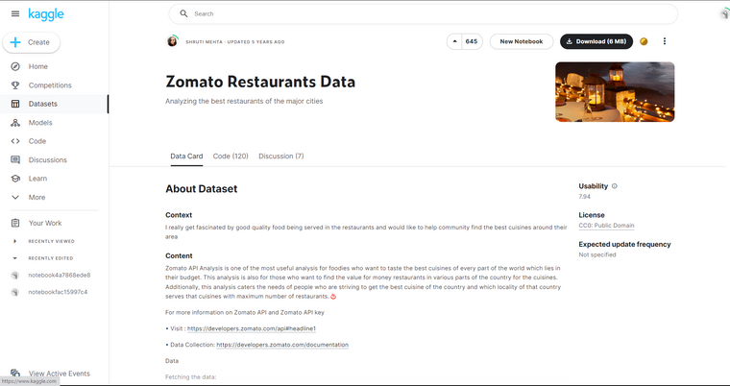

The project consist of 3 datasets:
Zomato_dataset
Country_codename
City_region
The analysis is done on Zomato_dataset with the help of Country_codename and City_region.
Zomato_dataset and Country_codename files were collected from Kaggle. City_region file was made for data cleaning purpose.
Notes:
There are 9551 rows and 21 columns.
So this is a huge data.
In the data cleaning section this dataset will be cleaned by using country_codename and city_region files.

Slide 9
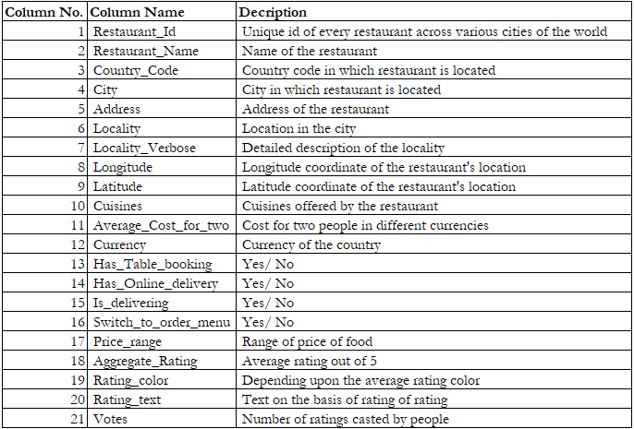
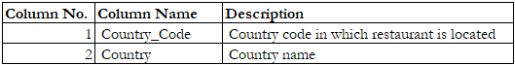
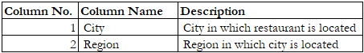
1
Zomato_dataset has 9551 rows and 21 columns.
2
Country_codename has 15 rows and 2 columns
3
City_region has 43 rows and 2 columns
Notes:
The zomato dataset includes information of restaurants from various countries and various cuisines.
That is why the dataset is huge.
As the analysis will be done using Zomato_dataset to optimize the process data cleaning has been done on this dataset by Remove irrelevant data.

Slide 10


Data Cleaning
with Excel Function and Query
Notes:
In this section, I have included the data cleaning process using Excel function and query.

Slide 11
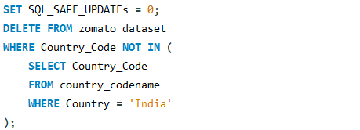
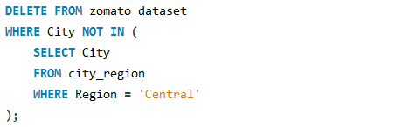
Zomato_dataset Cleaning
Using the find and replace function in the CSV file, all the "spaces" in the column names have been replaced with "underscores".
The CSV file is then sent to the pre-created database of MySQL server via CMD so that further cleaning can be done using Query.
Column Name | Motive for Cleaning | Query
Country_code | The column contains various country codes. For the analysis only country code of 'India' is needed.
City | The column contains the names of all the cities from all the regions of India. For the analysis only 'Central' region cities are needed.
Cuisines | The column contains all the cuisines. For the analysis only the rows containing 'North Indian' cuisines are needed.
Notes:
command prompt is used here for importing the file because this makes the process for importing quicker specially for a huge dataset like this.

Slide 12

Data Analysis
with Query and Insights with Visualization
Notes:
This is the most crucial section of the project.
In this section, I have created 7 questions, solved those questions using query, created charts for visualization of the query output, and included findings and solutions on the basis of visualization.

Slide 13

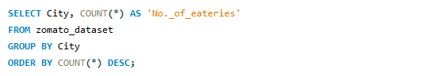

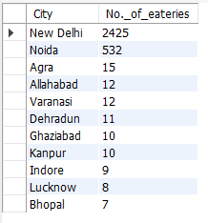

Query
Which cities have the most number of eateries?
Output

Slide 14
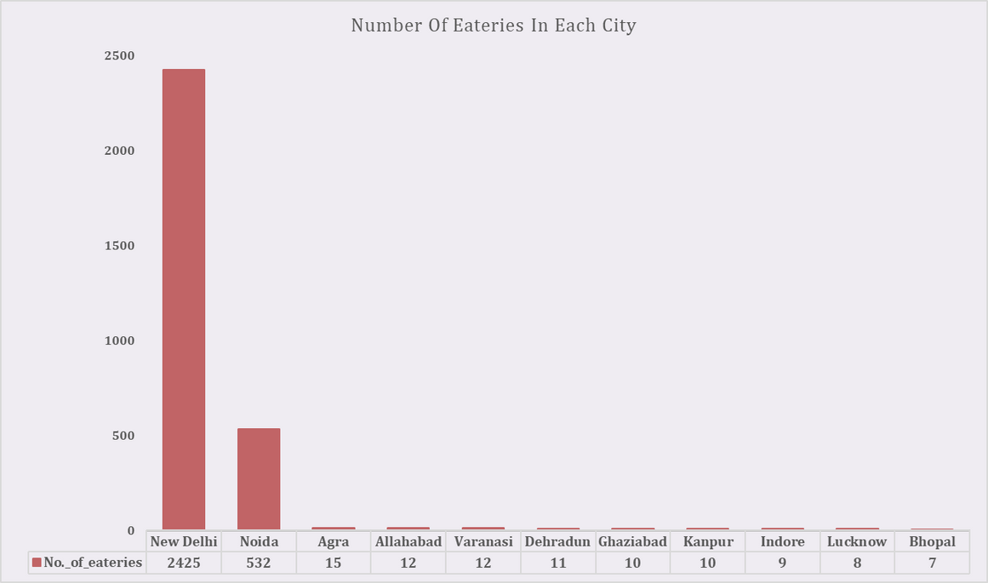
Findings
In New Delhi and Noida, there are more eateries. So, there is fierce competition in these cities.
Agra, Allahabad, Varanasi, Dehradun, Ghaziabad, Kanpur, Indore, Lucknow, and Bhopal have fewer eateries. So, there is less competition in these cities.
Solution
The eatery startup should concentrate on opening in cities with less competition.

Slide 15
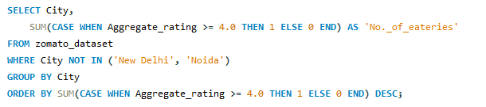
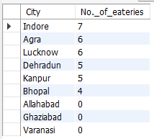
Query
Which low-competition cities have the most eateries with aggregated ratings more than 4?
Output
Notes:
to target the market gap

Slide 16
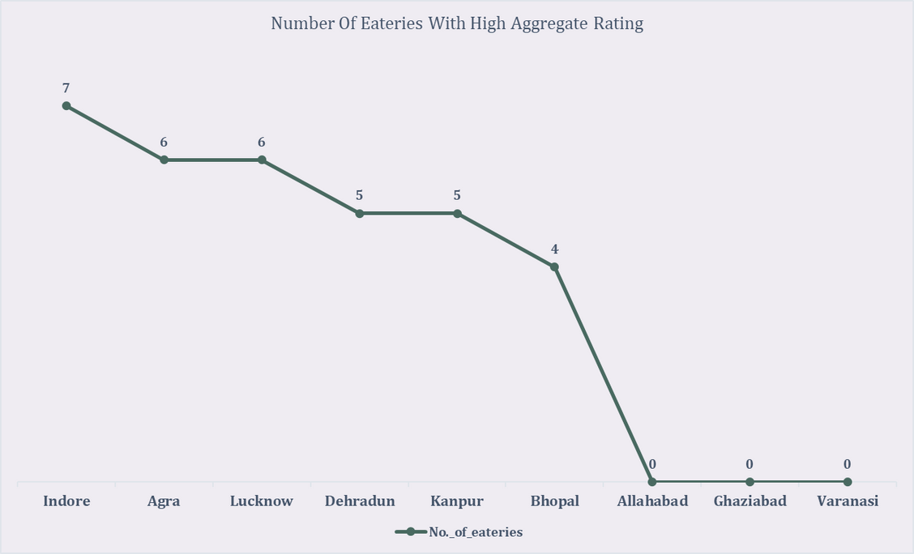
Findings
There are no eateries in Allahabad, Varanasi, or Ghaziabad with high aggregate ratings.
The number of eateries with high aggregate ratings is about the same in the other six low-competition cities.
Solution
To fill the need for a high-quality eateries, the eatery startup should concentrate on opening in Allahabad, Varanasi, and Ghaziabad.

Slide 17
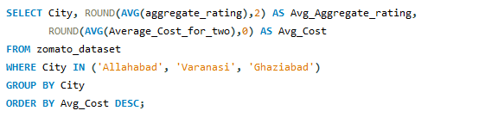
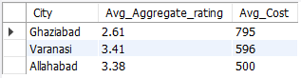
Query
What is the relationship between the Aggregate rating and the Average cost for two people at eateries in Allahabad, Varanasi, and Ghaziabad?
Output

Slide 18
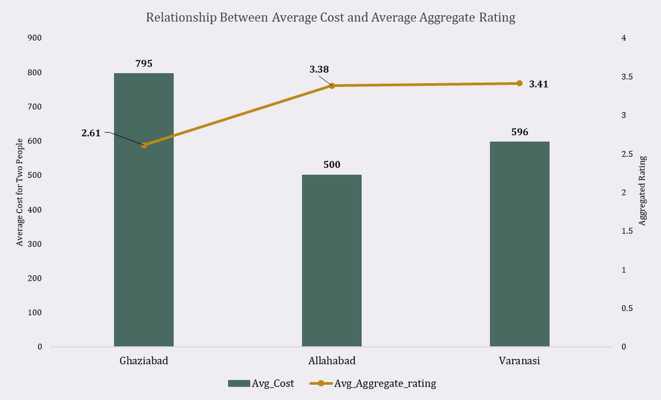
Findings
Ghaziabad has the lowest average aggregate rating and the highest average cost for two people in eateries.
Comparatively, Varanasi and Allahabad have higher average aggregate ratings and lower average cost for two people in eateries.
Solution
The eatery startup should launch a budget-friendly outlet in Ghaziabad, and comparably pricey outlets in Varanasi and Allahabad.

Slide 19
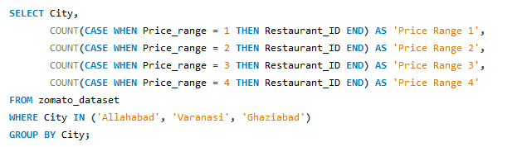
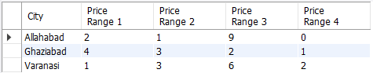
Query
How many eateries have a price range of 1, 2, 3, or 4 in Allahabad, Varanasi, and Ghaziabad?
Output

Slide 20
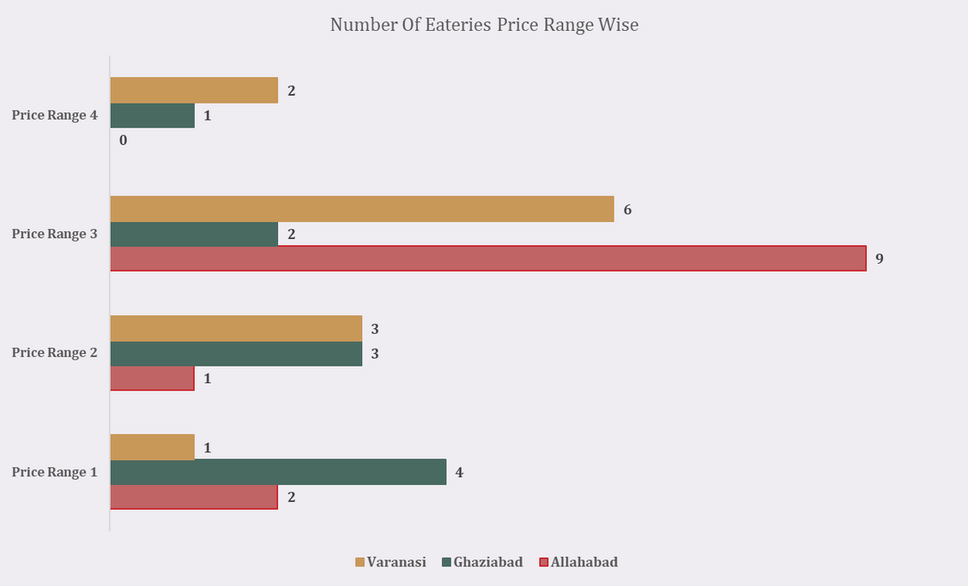
Findings
Allahabad has most of its eateries in Price Range 3.
Varanasi has most of its eateries in Price Range 3.
Ghaziabad has most of its eateries in Price Range 1.
Solutions
The Price Range of the eatery startup should be 3 in Allahabad and Varanasi.
The Price Range of the eatery startup should be 1 in Ghaziabad.

Slide 21
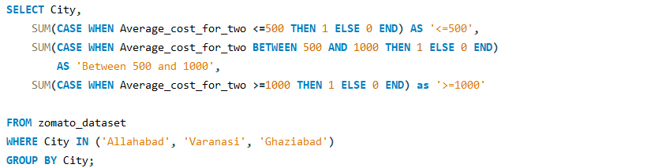
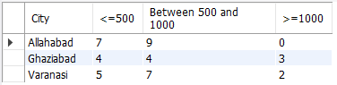
Query
How many eateries have an average cost for two people of less than Rs. 500, between Rs. 500 and Rs. 1000, and more than Rs. 1000 in Allahabad, Varanasi, and Ghaziabad?
Output

Slide 22
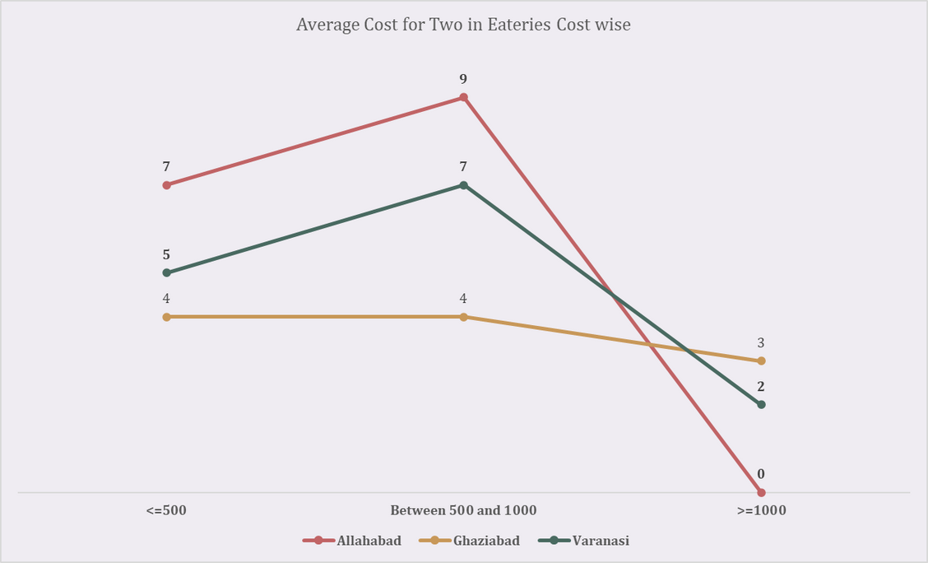
Findings
Very few eateries in Ghaziabad and Varanasi charge more than Rs. 1000 for two people, while there are none in Allahabad.
Allahabad and Varanasi have the most eateries which cost between Rs. 500 and Rs.1000 for two people.
Ghaziabad has the most eateries which cost between Rs. 500 and Rs.1000 and less than Rs. 500 for two people.
Solutions
The eatery startup should have the price of its items between Rs. 500 and Rs. 1000 in Allahabad and Varanasi.
In Ghaziabad, it should have the majority of items that are priced less than or equal to Rs. 500.

Slide 23
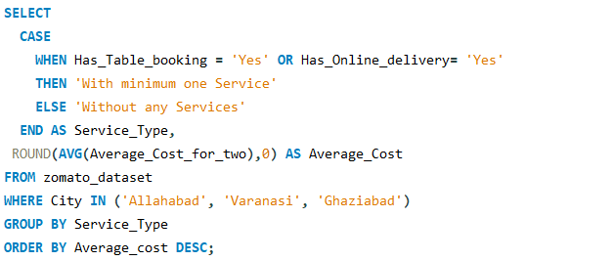
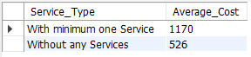
Query
How do eateries with table booking or online delivery services compare in terms of pricing with eateries that do not offer these services in Allahabad, Varanasi, and Ghaziabad?
Output

Slide 24
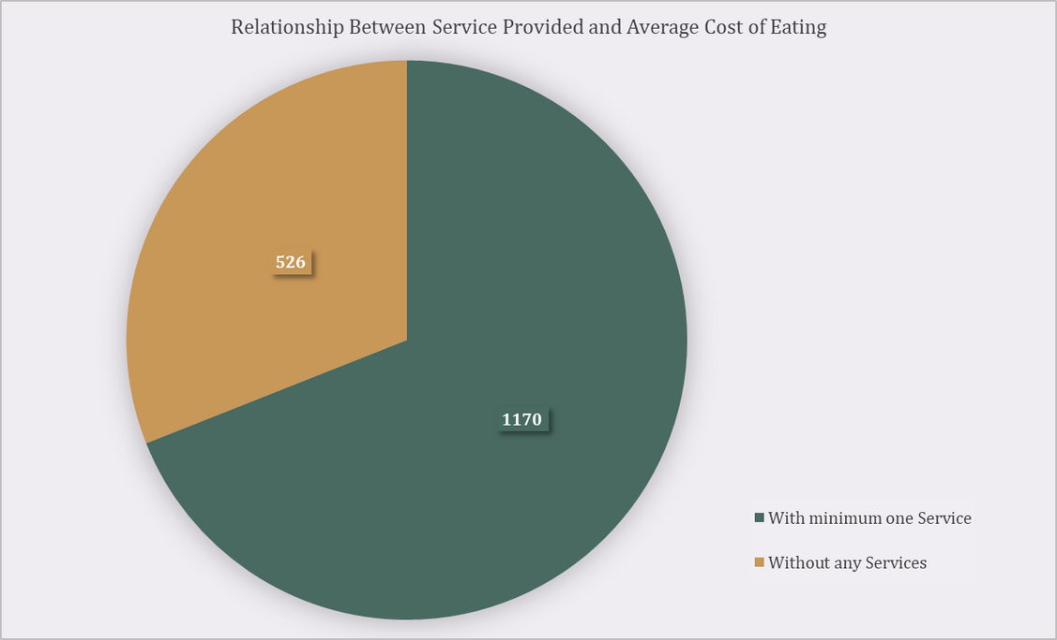
Findings
The average cost of eating is low in eateries that do not provide any in Allahabad, Varanasi, and Ghaziabad.
The average cost of eating is significantly greater in eateries that provide minimum one service between Table booking and Online delivery in Allahabad, Varanasi, and Ghaziabad.
Solution
The eatery startup should provide either Table booking or Online delivery service in Allahabad, Varanasi, and Ghaziabad.

Slide 25
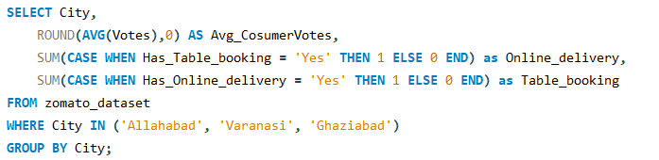
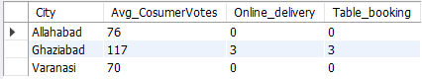
Query
How many eateries offer Online delivery or Table booking service and what are their average consumer votes in Allahabad, Varanasi, and Ghaziabad?
Output

Slide 26
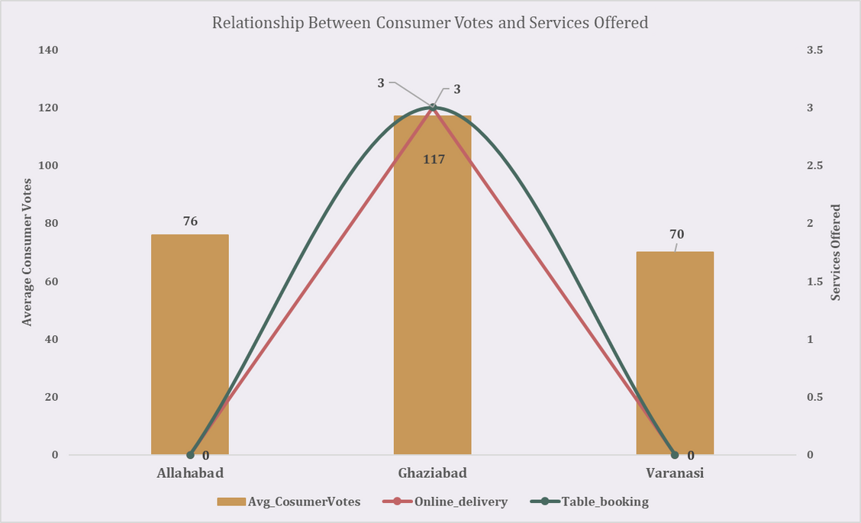
Findings
Eateries in Ghaziabad offer Table booking and Online delivery services hence the average consumer vote is much higher than in Allahabad and Varanasi.
Solutions
The eatery startup should provide both services in Allahabad and Varanasi.
In Ghaziabad, the company can provide either Table booking or Online delivery service.

Slide 27



Recommendations
To meet the need for high-quality eateries, the eatery startup should focus on opening in low-competition cities such as Allahabad, Varanasi, and Ghaziabad.
The eatery startup should open a budget-friendly outlet in Ghaziabad, and comparably pricey outlets in Varanasi and Allahabad. The average cost of eating for two should not exceed Rs. 1000.
The eatery startup should provide both Table booking and Online delivery services in Allahabad and Varanasi, and a minimum of one service in Ghaziabad.
Notes:
In the end I have made some recommendations based on the analysis solutions.

Slide 28





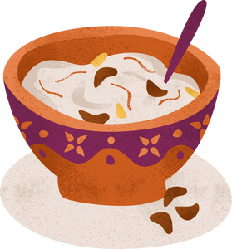


Thank You
For Watching!

